Slide 1
MALARIA DETECTION USING MACHINE LEARNING
Project Presentation
on
By
Shivam Tiwari (1901320100154)
Priya Gupta (1901320100117)
Minay Ghai (1901320100095)
Prashant Kumar (1901320100111)
Under the guidance of
Mr. Virendra Pal Singh
Greater Noida Institute of Technology

Slide 2
Outline of Presentation
Introduction
Objective
Literature Survey
Methodology
Hardware/Software requirement
Result
Future Scope
Conclusion
References

Slide 3
Introduction
Malaria is a life-threatening disease caused by Plasmodium parasites transmitted through the bites of infected Anopheles mosquitoes.
Malaria is generally caused by mosquitos and they grow their population in areas with standing water or stagnant water, such as swamps, ponds, puddles, or areas with poor drainage which help mosquitoes to grow faster.
Early detection of malaria can lead to timely treatment and prevent the progression of the disease to severe stages. It can reduce the chances of complications and fatalities.
Conventional diagnostic methods are time consuming and require trained personnel. Machine learning (ML) techniques offer an efficient and accurate approach to diagnose malaria through the analysis of blood samples.

Slide 4
Introduction
Machine learning-based malaria detection systems have the potential to be cost-effective, especially in resource-limited settings.
Early and accurate detection of malaria plays a crucial role in effective disease management, prevention of complications, reduction of transmission, and overall public health.
Traditional malaria diagnostic methods, such as microscopy and rapid diagnostic tests, have limitations in terms of speed and scalability. Machine learning-based approaches can expedite the diagnosis process by automating image analysis, data interpretation, and decision-making.
Machine learning-based approaches can expedite the diagnosis process by automating image analysis, data interpretation, and decision-making.

Slide 5
Objective
This project aims at predicting the crops diseases by using the image processing of the images of the diseased plants using the deep learning model.
In the past decades, there is an increasing interest in predicting crops diseases among farmers, researchers, academics and agro-based companies.
The objective of the proposed work is to study and improve the deep learning algorithms to predict the crops diseases using the images of the leaves.

Slide 6
Literature Survey
K-MEANS AND AI FOR CROP DISEASE
Recognizable proof of a disease in a crop is a way of noting mishaps in the productivity and quantity of the plant item. These investigations of maladies include the overview of examples visible on it.
IMAGE PROCESSING FOR SMART FARMING
Harvests are deeply influenced by the non-uniform and unpredictable changes in the climate which leads to the prompting of a diminished agrarian yield. This influences worldwide rural economy.
FUNGAL DISEASE IDENTIFICATION IN CROPS
Due to the rise of computers, our way of life has changed dramatically. They have made a significant impact in all walks of life through powerful and flexible devices. Agriculture and horticulture are no different from the norm.

Slide 7
Literature Survey
STRATEGIES FOR LEAF DISEASE DETECTION
India is an agriculture-centric nation. Ranchers have wide scope of assorted variety to choose reasonable foods grown from the ground crop.
DETERMINATION OF SEVERITY IN LEAF DISEASES
Fungi growths causing illnesses in plant of sugarcane are a very overwhelming illnesses which are present as leaf spots.
DISEASES DETECTION USING IMAGE PROCESSING
Diseases in plants have transformed into an issue because it causes noteworthy decrease in standard and quantity of rural growth.70% of the populace rely upon agribusiness in India.
DISEASE DETECTION IN PLANTS USING ANN
Agriculture is a very important domain terms of growth, especially for our country. It is a skipping stone in human evolution.

Slide 8
Methodology
Blood sample collection
Microscopic image
Image upload on Model
Image Segmentation
Image Analysis
Feature Extraction
Malaria identification

Slide 9
Methodology
Data Collection:
The first step in the methodology is collecting the dataset of leaf images for potato, wheat, and rice crops.
Data Pre-processing:
Once the dataset is collected, the next step is to pre-process the leaf images. This involves applying various techniques to enhance the quality of the images and standardize the input for the disease detection model.
Model Selection:
After data pre-processing, the appropriate model needs to be selected for disease detection. This step involves choosing a suitable machine learning or deep learning model.

Slide 10
Methodology
Model Training:
Once the model is selected, the next step is to train it using the pre-processed dataset. During the training phase, the model's parameters are adjusted using an optimization algorithm, such as stochastic gradient descent (SGD), to minimize the loss function.
Model Evaluation:
After training, the model is evaluated to assess its performance in disease detection. This step involves testing the trained model on a separate test dataset that was not used during training.

Slide 11
Hardware/Software requirement
Hardware
Software
Processor : Pentium
RAM : 2GB or above
HDD : 100GB or
above
O.S : Windows XP
or advanced
Front-End : React JS
Back-End : Python &
NodeJs
IDE : PyCharm
Web-Browser : Chrome/Firefox/Microsoft

Slide 12
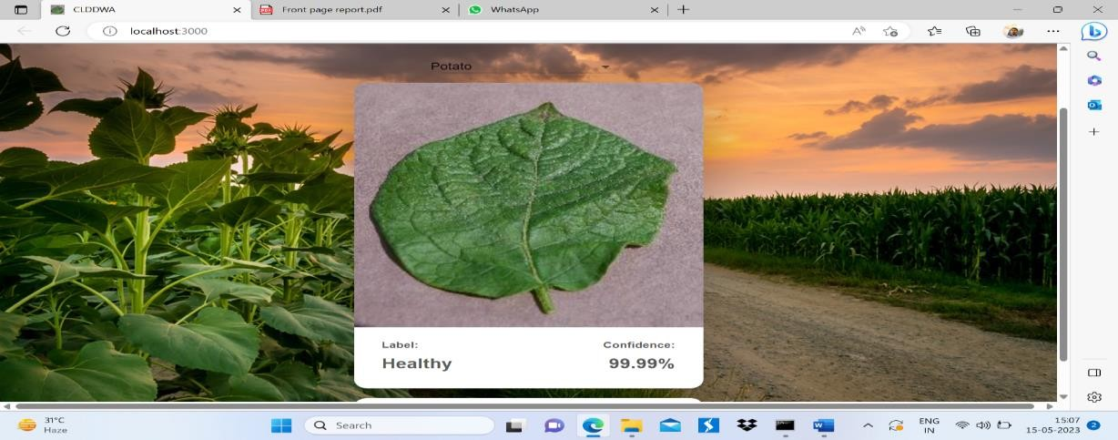
Results

Slide 13
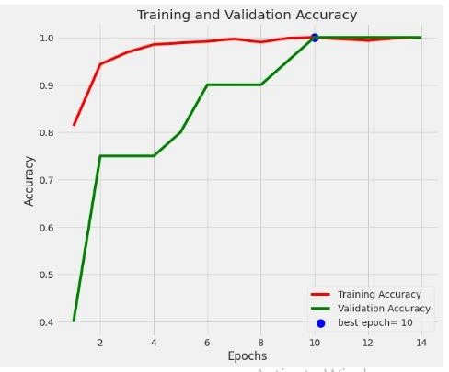
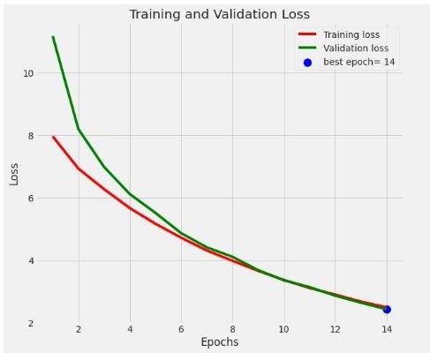
Results

Slide 14
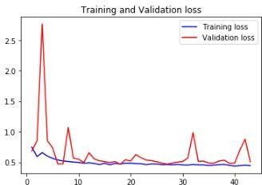
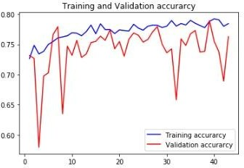
Results

Slide 15
Results
Accuracy (in %)
after performing test of potato - 93.99
Accuracy(in %)
after performing test of rice - 76.29

Slide 16
Conclusion
The proposed system predict malaria.
CNN and DNN algorithms are used for early detection of plant diseases.
It uses machine learning techniques to train models and help make better disease decisions.
Patient are encouraged to stay healthy and avoid to have any diseases.
In the future, the proposed system could be expanded to provide additional facilities such as medical report, other medical disease detection, nearby hospital appointment.

Slide 17
Future Scope
In terms of neural network, modifications can be done by adjusting with different optimizers and loss functions. An increase in the number of layers can also be done.
The scope of the number of diseases can be increased for a more expanded view on the subject by training the algorithm.
A different architecture can also be used for implementing neural network such as Artificial Neural Network.
More machine learning algorithms can be used to increase the accuracy of malaria detection.
An android application can also be created, which caters to a large user base.

Slide 18
References
Uday Arun, et al.” malaria detection using machine learning” International Research Journal of Engineering and Technology Volume: 07 Issue: 12 | Dec 2020 https://www.irjet.net.
Fred N. Kiwanuka, et al. “Automated Blood Smear Analysis For Mobile Malaria diagnosis” Research Gate Publication(RGP) March 2014 http://www.researchgate.net/publication/266146329
Priya Singh, et al.” malaria detection System using Microscopic Blood Smear image” International Research Journal of Engineering and Technology Volume: 09 Issue: 05 | May 2022 https://www.irjet.net.
D Ghate, C. Jadhav, and N. U. Rani, A., and S. Busa., "AUTOMATIC DETECTION OF MALARIA PARASITE FROM BLOOD IMAGES,". [Online]. Available: http://ijact.org/volume4issue1/IJ0410050.pd f. Accessed: Jan. 25, 2020

Slide 19
References
WHO Malaria microscopy quality assurance manual- version-2 World Health Organization.
World Health Organization. Malaria: fact sheet No. WHO-EM/MAC/035/E. World Health Organization , Regional Office for the eastern Mediterranean
Wilson, M. L. (2012). Malaria rapid diagnostic tests. Clinical infectious diseases, 54(11), 1637-1641.
Gollin, D., & Zimmermann, C. (2007). “Malaria: Disease impacts and long-run income differences”.
Hinton, G., Vinyals, O., & Dean, J. (2015). “Distilling the knowledge in a neural network”. arXiv preprint arXiv:1503.02531.

Slide 20
References
Ahirwar A., Pattnaik S., Acharya B., Advanced Image Analysis Based System Learning Algorithms and Image Processing. 7(2), 68–70
Mishra, V. K., Kumar, S., & Shukla,N. (2017) “Automatic Detection and Classification of Malarial Parasite in Blood
Images.” International Journal of Information Technology and Knowledge Management. Jan-June 2012, Volume 5, No 1, pp. 59-64
Chari, K., & A. An Impact of incorrect on waterfall software Empirical Software Engineering Agrawal, M. (2018). and new requirements project outcomes.
Centers For Disease Control and Prevention , website for information about malaria ,https://www.cdc.gov/malaria/about/faqs.html

Slide 21
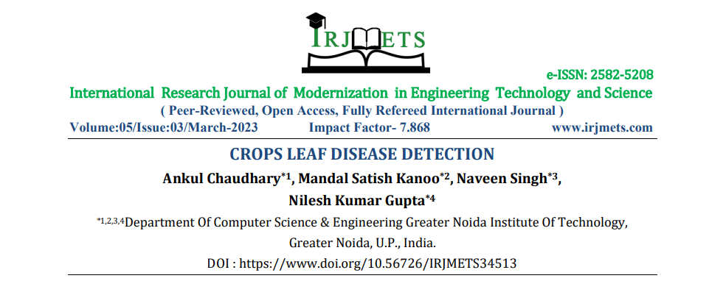
Research paper published by us

